Slide 1


Data Analysis
Social Buzz

Slide 2


Today's agenda
Project recap
Problem
The Analytics team
Process
Insights
Summary

Slide 3

z
Social Buzz is a fast growing technology unicorn that need to adapt quickly to it's global scale. Accenture has begun a 3 month POC focusing on these tasks:
• An audit of Social Buzz's big data practice
• Recommendations for a successful IPO
• Analysis to find Social Buzz's top 5 most
popular categories of content
Project Recap

Slide 4

Problem
Over 100000 posts per day
36,500,000 pieces of content per year!
But how to capitalize on it when there is so much?
Analysis to find Social Buzz's top 5 most popular categories of content

Slide 5



Andrew Fleming
Chief Technical Architect
The Analytics team
Marcus Rompton
Senior principle
Sai Ratna Sohith S
Data Analyst

Slide 6
Process
1
Data Understanding
2
Data Cleaning
3
Data Modelling
4
Data Analysis
5
Finding Insights

Slide 7

Insights
Most popular category is Animals with a total score of 74965
Highest number of posts in May
16 unique categories in total

Slide 9
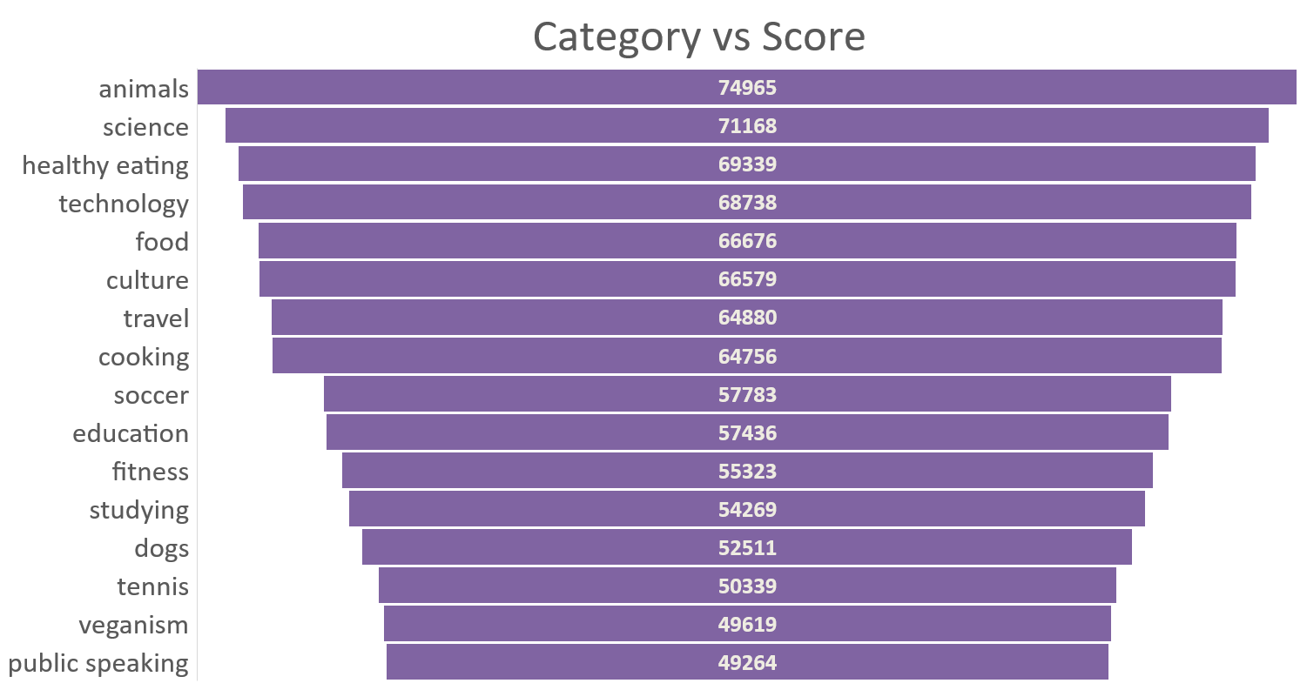

Slide 10

ANALYSIS AND INSIGHTS
Invest more resources in enhancing Science and Technology content to capitalize on strong audience engagement.
Pursue sponsorship deals in Technology and Science, and introduce premium content options for Healthy Eating and Food categories.
Translate and localize Healthy Eating and Food content to attract a global audience, while tailoring Animals and Science content for regional markets.
Summary

Slide 11
Thank you!

